Slide 1

Microsoft Orleans
Richard Astbury
Microsoft

Slide 2

Programming for IoT
Millions of devices
High message throughput
React rapidly to events
Devices interoperate
Notes:
What kinds of problems does Orleans solve?
A lot has changed in the world since I started programming 30 years ago….
Large systems, such as IoT, public websites, have to deal with high traffic volumes
They must react rapidly to events, people want instant feedback
We have to model connections – chat, devices in an IoT system collaborating, East-West traffic in the data datacentre
Interestingly language hasn’t changed that much

Slide 3
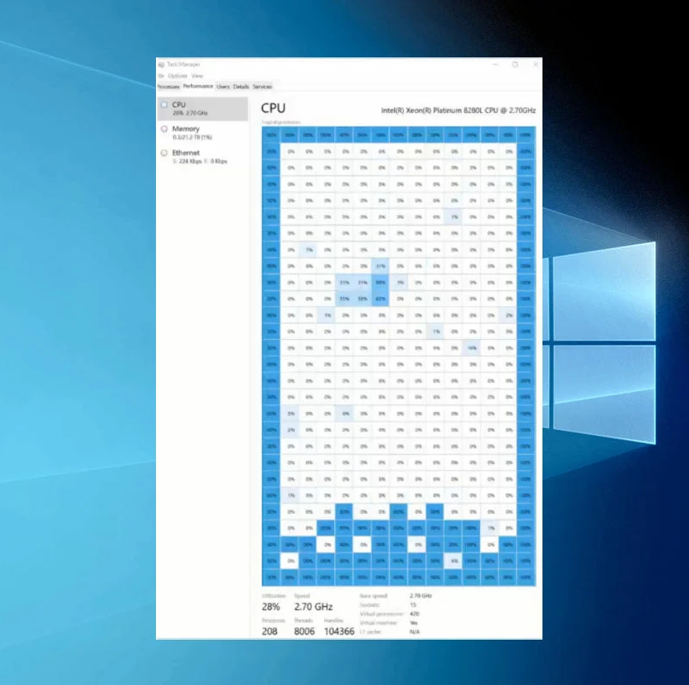
Programming for Multicore
Computers gaining more cores
Concurrent Programming is hard
Languages and tooling offer little help
Notes:
I used to program for a machine with a single CPU, now multicore systems are the norm
440 core machines, task manager, tetris
Concurrent programming is hard, it’s someties hard to split code into small concurrent pieces that run concurrently.
Languages offer some help, TPL in C# allows you dispatch tasks on a threadpool.
Lack of concurrency warnings,
Strange runtime errors (race conditions)
Hard to code, hard to debug

Slide 4

Programming for Cloud
Horizontal Scalability
Fault tolerance
Notes:
Cloud computing
Massive horizontal scalability
Hardware failure didn’t really exist when I started programming,
Now we have to deal with computers/networks transient outages etc…

Slide 5




3-Tier Architecture
Client
Web API
Database
Stateless
Scale Horizontally
State and concurrency
Cache
State
Notes:
We deal with horizontal scalability by running lots of small instances of the same programming
Stateless
Load data from DB for every request
Cache to improve perf
Now we have data in two places, cache invalidation is a problem
There’s nothing wrong with this, but it’s not idea

Slide 6
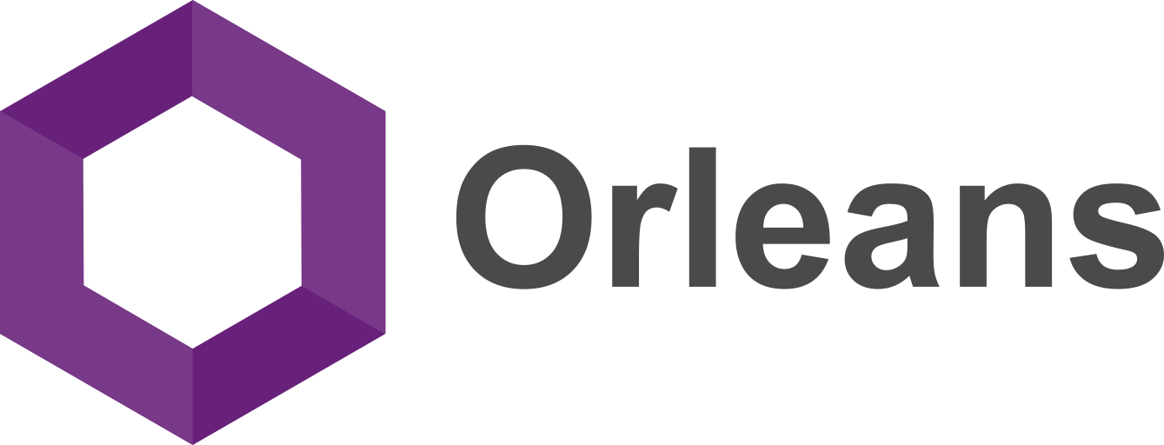
Notes:
Orleans was conceived as a framework to meet modern workloads with cloud native applications

Slide 7

Microsoft Orleans
Framework for building distributed systems
Microsoft Research project
Designed for the Cloud
Rethink of application architecture

Slide 8
Microsoft Orleans
A distributed .NET runtime
Embraces state
Turn-based concurrency model
Fault-tolerant system

Slide 9

Halo 4

Slide 10
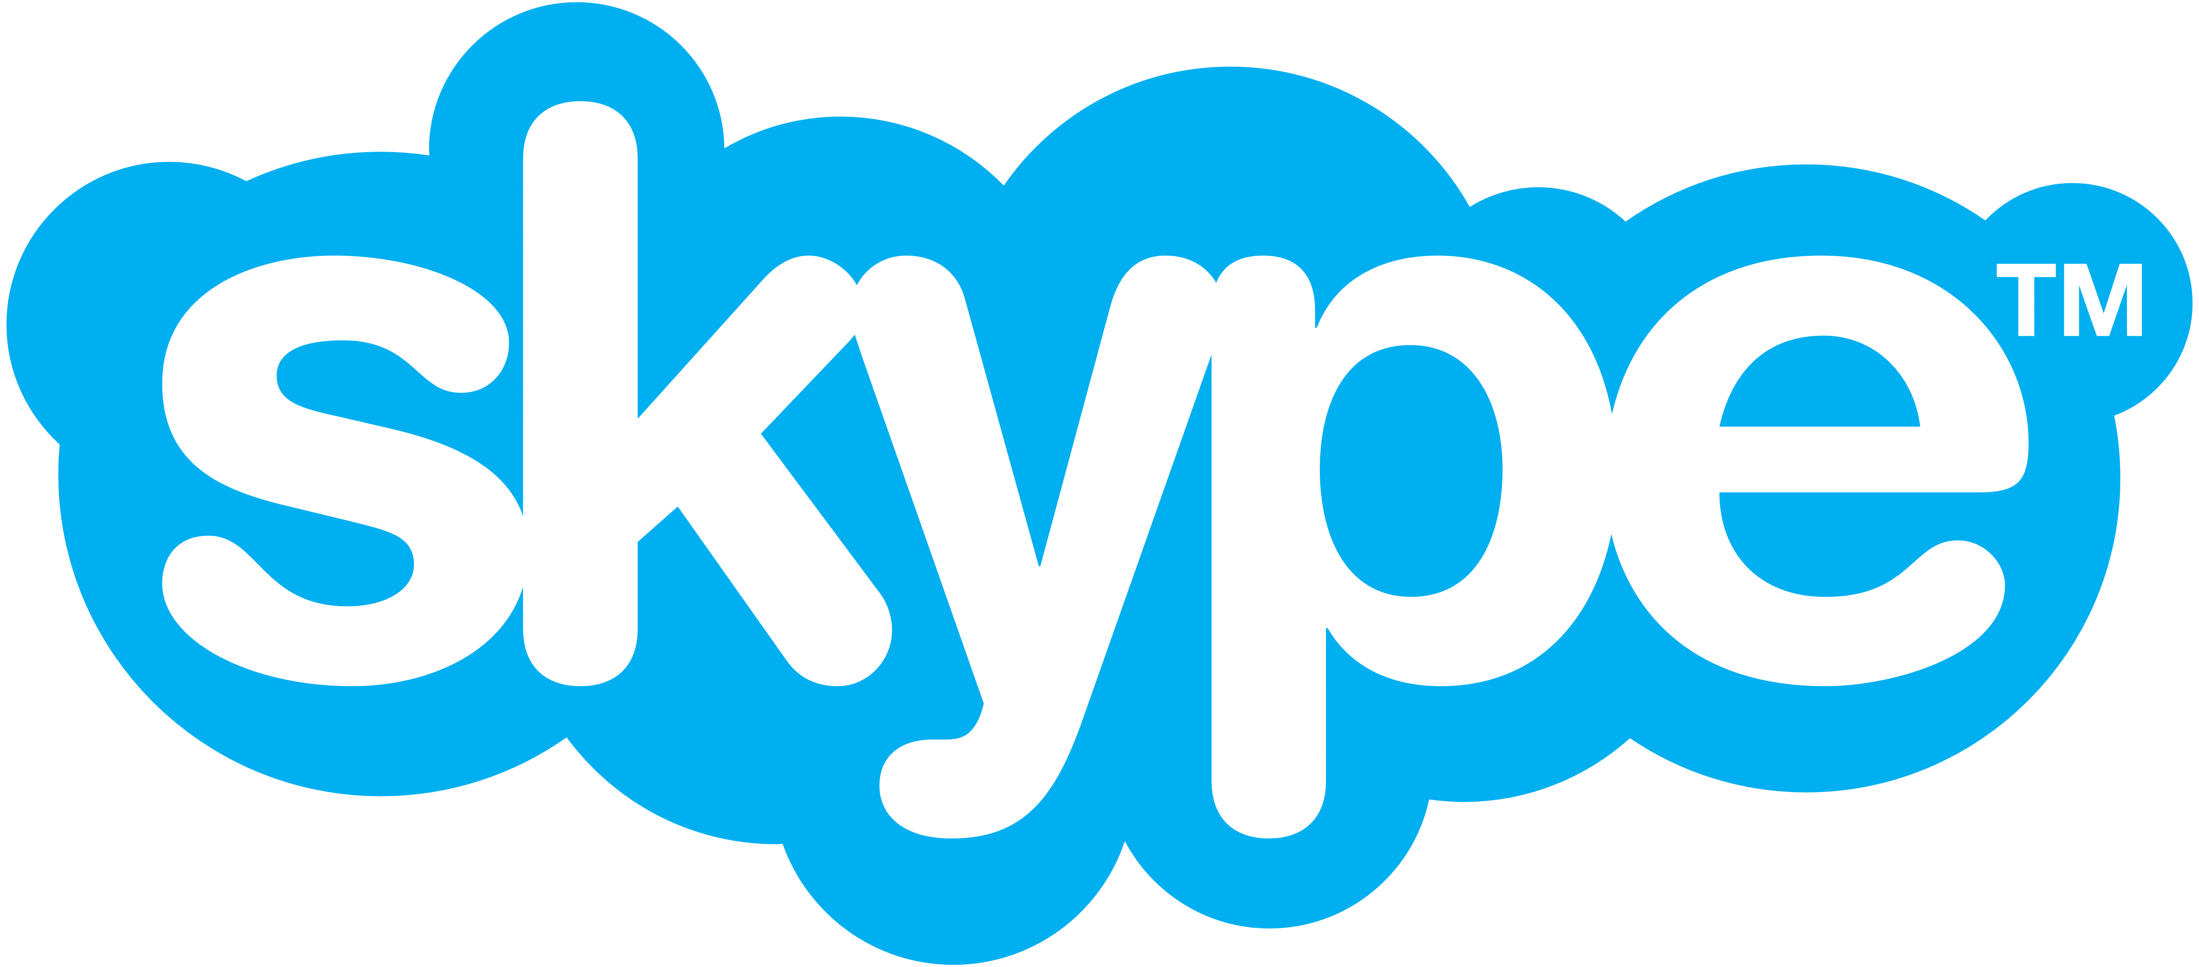


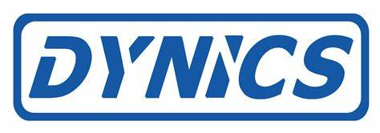
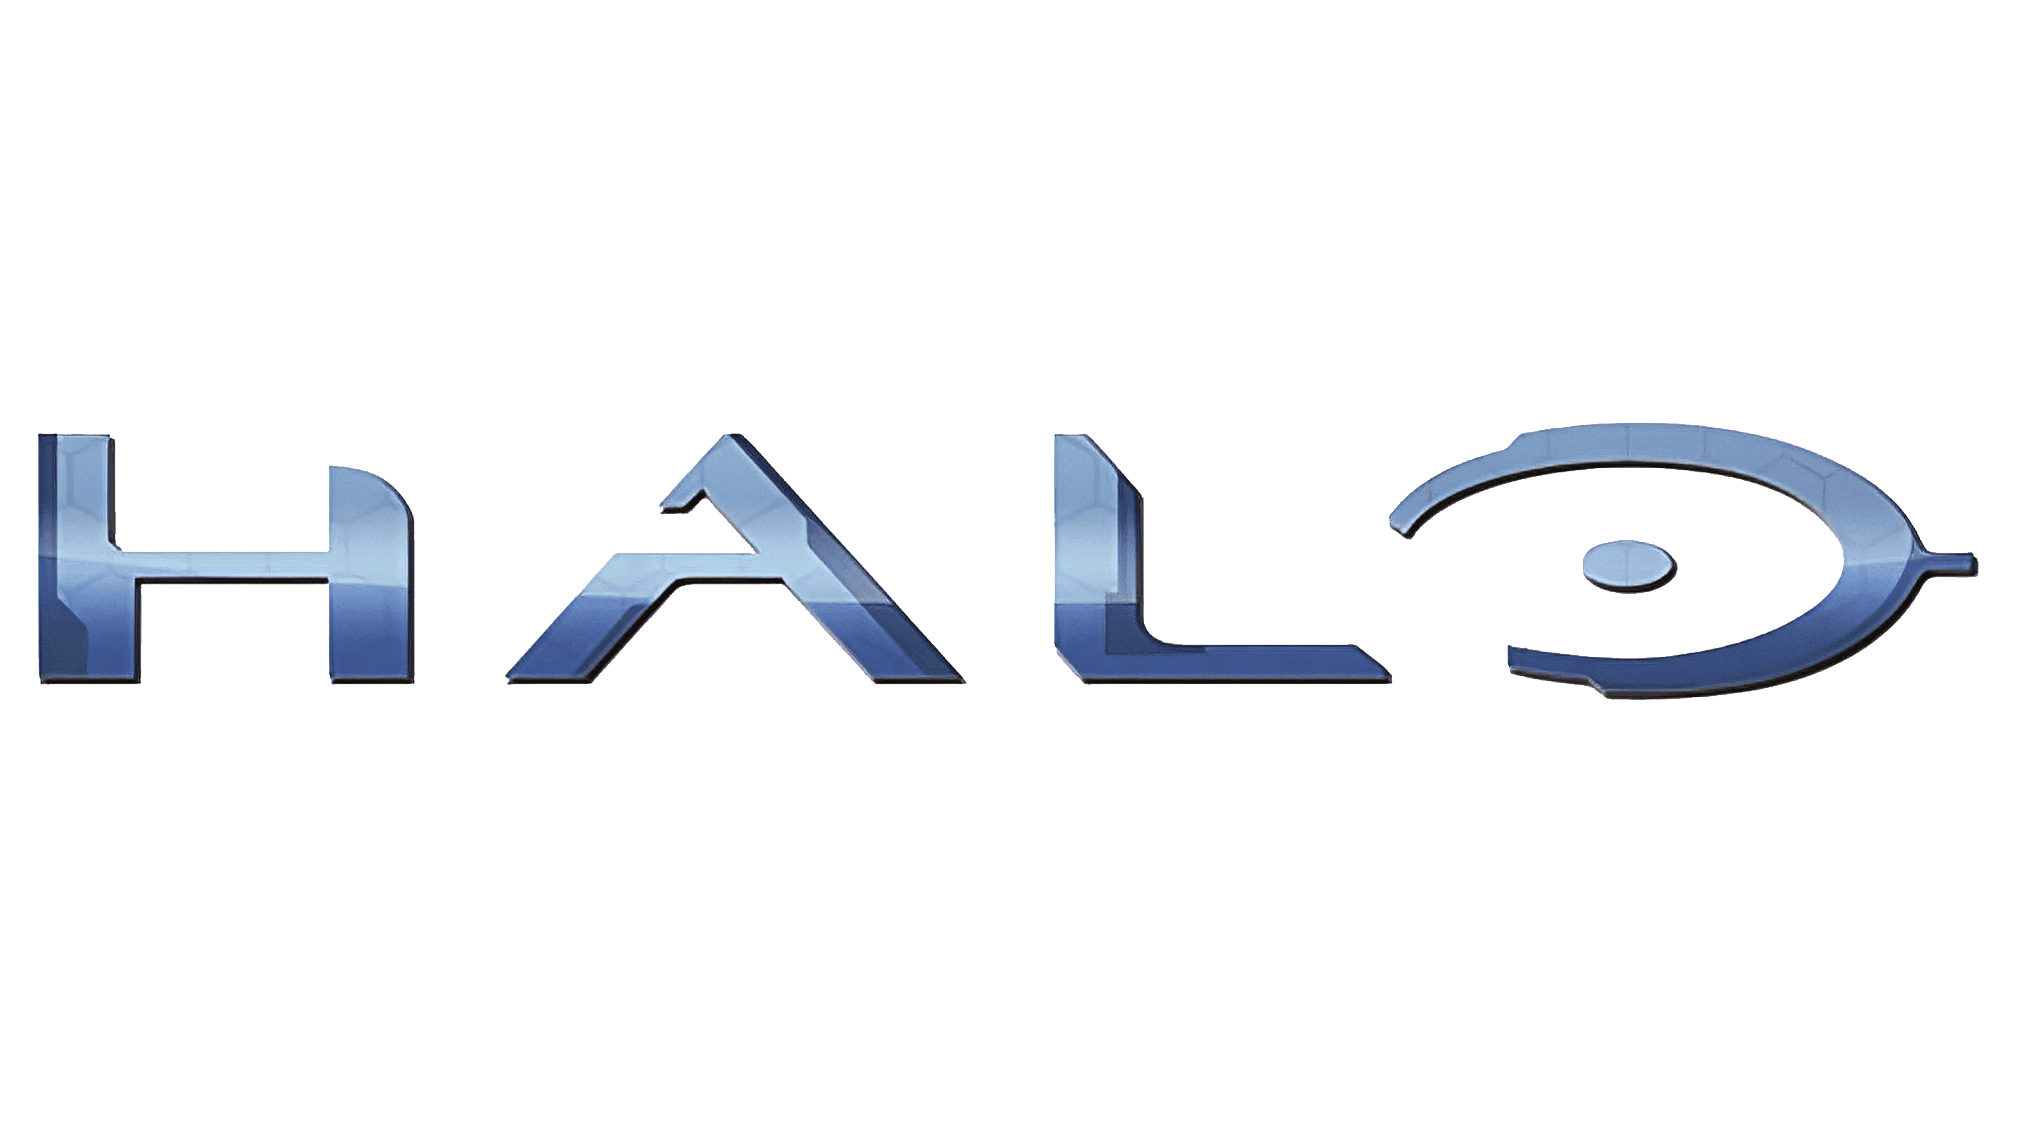




Notes:
Orleans was conceived as a framework to meet modern workloads with cloud native applications

Slide 11

Orleans Architecture
Client
Web API
Orleans
Database
Stateless
Scale Horizontally
Stateful
Scale Horizontally
Persistent Store

Slide 12
Orleans Architecture
Orleans
Client
Web API
Database

Slide 13

Features of a Grain
Identity + Logic
+
State

Slide 14

Programming a Grain
Small, simple programming model
Single threaded
Async

Slide 15

Programming a Grain
Communication via async message passing
Messages are queued
No shared state

Slide 16
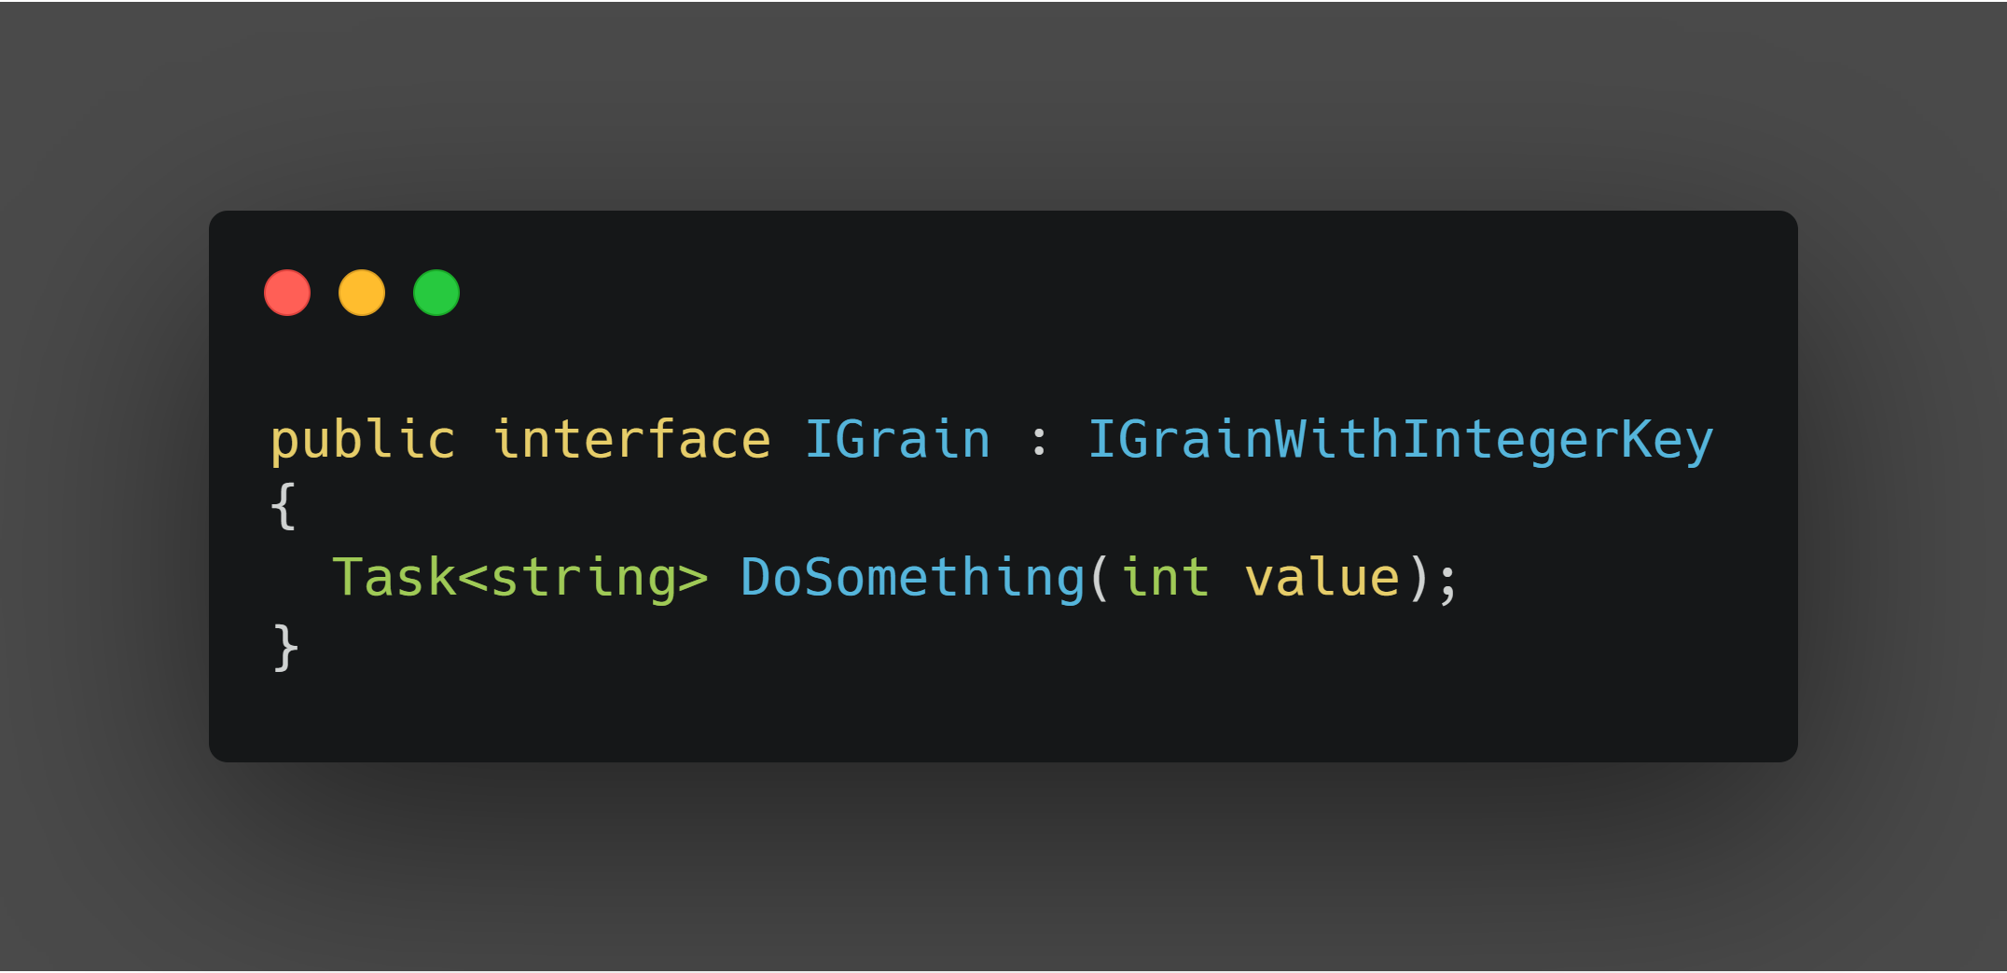

Slide 17
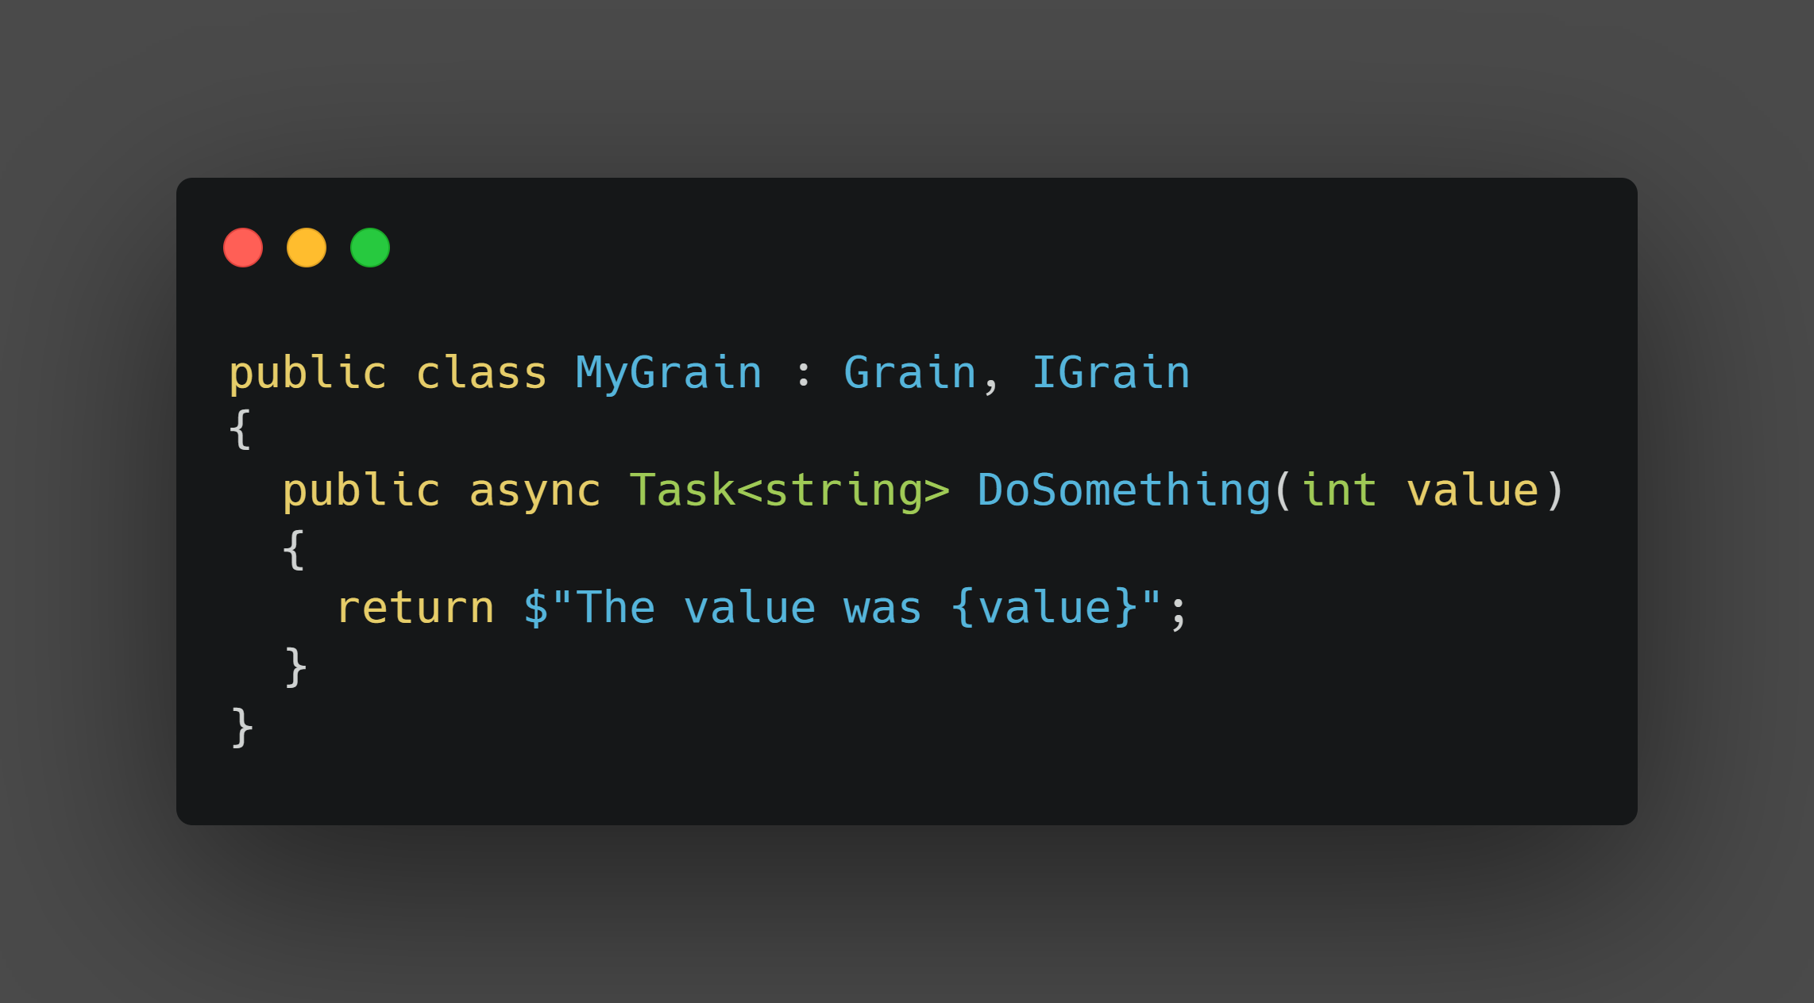

Slide 18
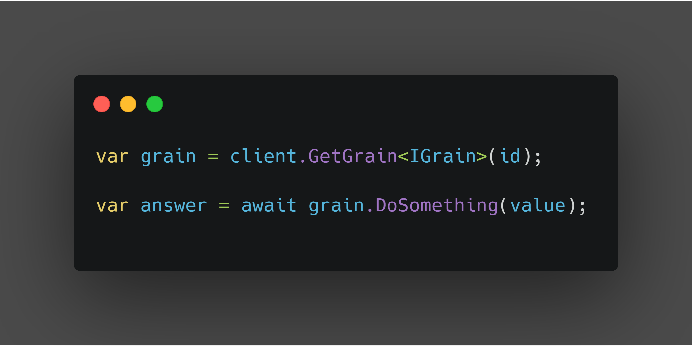

Slide 19
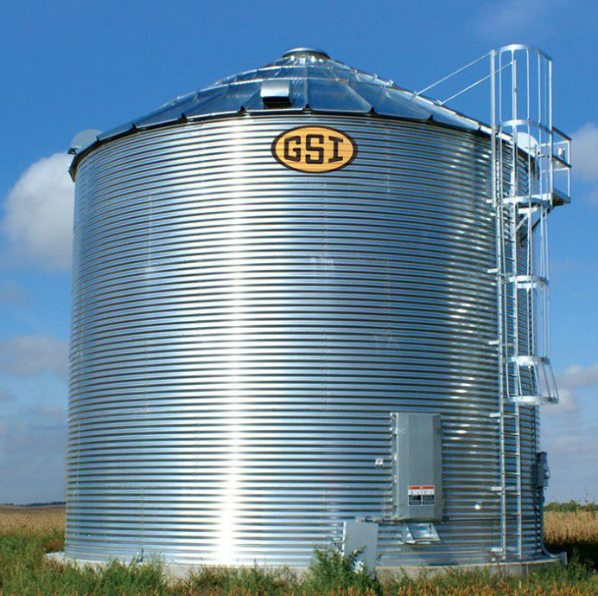
Features of a Silo
Hosts grains
Manages grain lifecycle
.NET DLL / Console Application
Designed to work together (clustered)

Slide 20

Programming in Orleans
Simplified concurrency
Maintaining state in memory drives low latency
Scalable, fault tolerant and built for the cloud

Slide 21
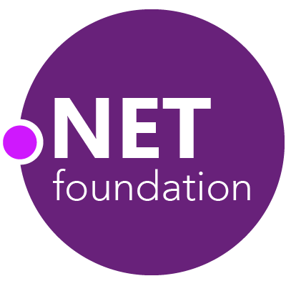

https://github.com/dotnet/orleans

Slide 22
Demo

Slide 23
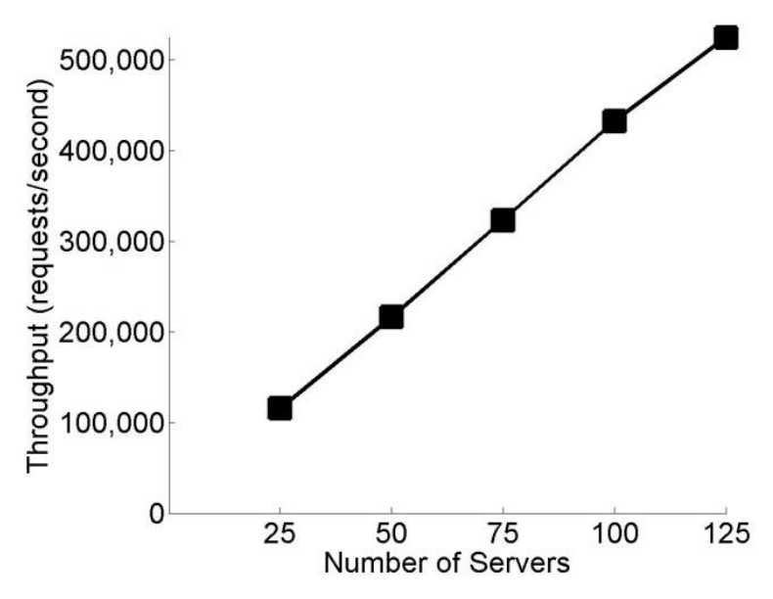
Scalability

Slide 24
Advanced Concepts
Timers and Reminders
Persistence
Streams
Heterogeneous Silos
Event Sourcing
Transactions

Slide 25
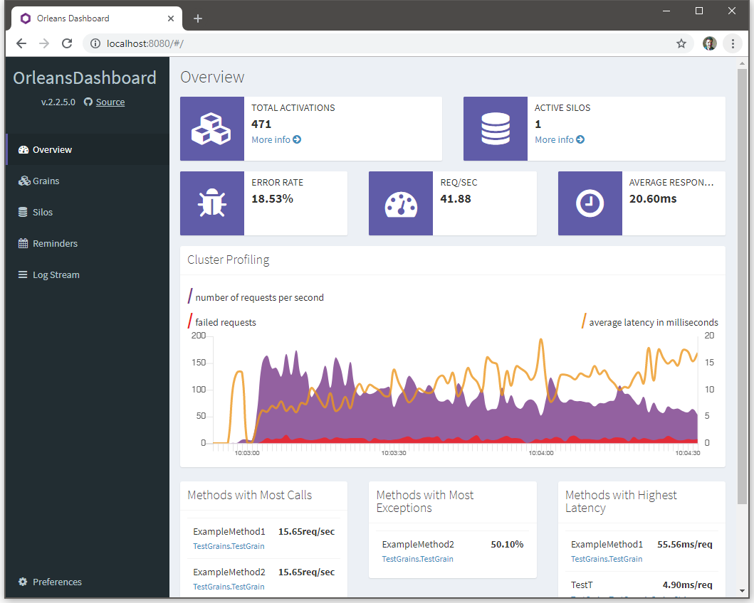

Slide 26

Orleans makes programming a cluster of machines feel like a single computer It’s great for systems requiring high availability, high throughput, low latency or concurrency

Slide 27

Thank you

